Slide 1


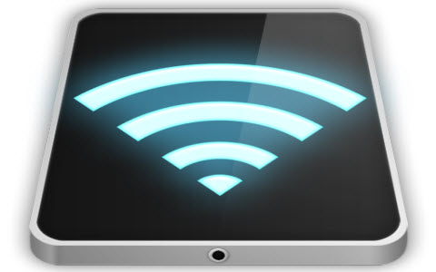
Wireless Technologies for IoT: 3230422
Dr. Namita Arya
IoT department

Slide 2


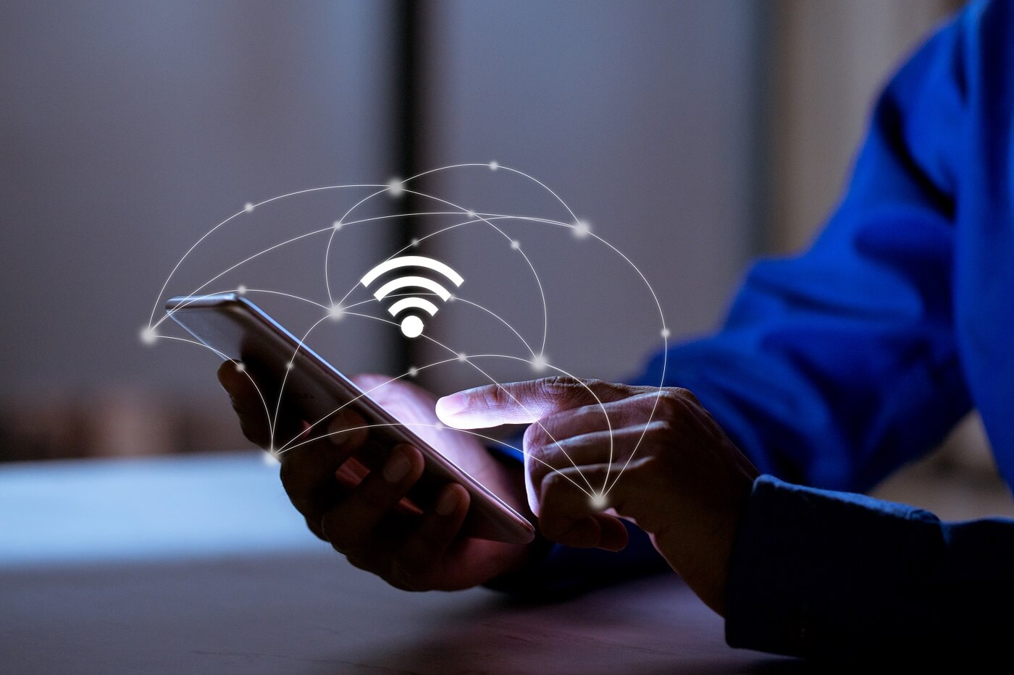
Unit-1

Slide 3
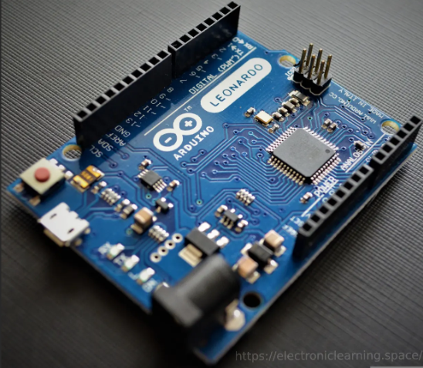
Arduino

Slide 4


What is an Arduino?
Arduino is an open-source platform used for building electronics projects.
Arduino consists of both a physical programmable circuit board (often referred to as a microcontroller) and a piece of software, or IDE (Integrated Development Environment) that runs on your computer, used to write and upload computer code to the physical board.
The Arduino platform has become quite popular with people just starting out with electronics, and for good reason.
Unlike most previous programmable circuit boards, the Arduino does not need a separate piece of hardware (called a programmer) in order to load new code onto the board -- you can simply use a USB cable.
Additionally, the Arduino IDE uses a simplified version of C++, making it easier to learn to program. Finally, Arduino provides a standard form factor that breaks out the functions of the micro-controller into a more accessible package.

Slide 5
What Does it Do?
The Arduino hardware and software was designed for artists, designers, hobbyists, hackers, newbies, and anyone interested in creating interactive objects or environments.
Arduino can interact with buttons, LEDs, motors, speakers, GPS units, cameras, the internet, and even your smart-phone or your TV!
This flexibility combined with the fact that the Arduino software is free, the hardware boards are pretty cheap, and both the software and hardware are easy to learn has led to a large community of users who have contributed code and released instructions for a huge variety of Arduino-based projects.

Slide 6


What makes up an Arduino?
Arduinos contain a number of different parts and interfaces together on a single circuit board.
The design has changed through the years, and some variations include other parts as well.
But on a basic board, you’re likely to find the following pieces:
A number of pins, which are used to connect with various components you might want to use with the Arduino. These pins come in two varieties:
Digital pins, which can read and write a single state, on or off. Most Arduinos have 14 digital I/O pins.
Analog pins, which can read a range of values, and are useful for more fine-grained control. Most Arduinos have six of these analog pins.

Slide 7
Arduino UNO Pinout
The Arduino UNO is a standard board of Arduino, which is based on an ATmega328P microcontroller. It is easier to use than other types of Arduino Boards.
The Arduino UNO Board, with the specification of pins, is shown below:

Slide 8
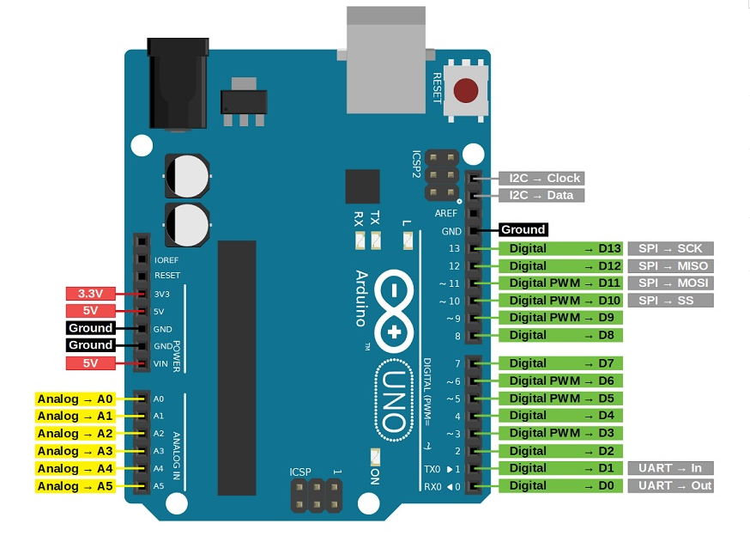

Slide 9
Arduino Uno (R3)
As we discussed we know that Arduino Uno is the most standard board available and probably the best choice for a beginner.
We can directly connect the board to the computer via a USB Cable which performs the function of supplying the power as well as acting as a serial port.

Slide 10
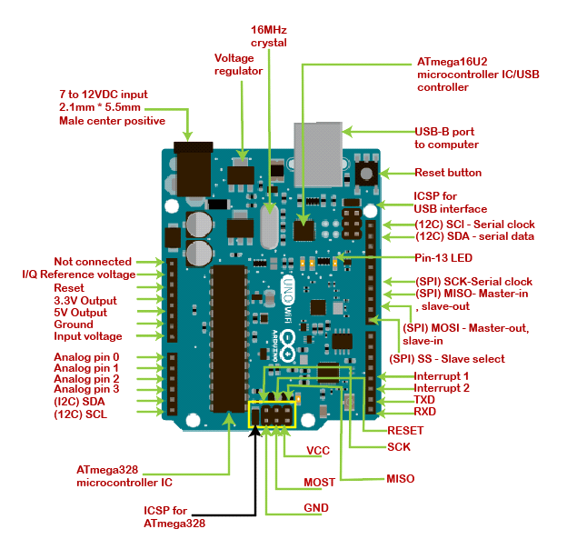

Slide 11








Pin Configuration
Vin: This is the input voltage pin of the Arduino board used to provide input supply from an external power source.
5V: This pin of the Arduino board is used as a regulated power supply voltage and it is used to give supply to the board as well as onboard components.
3.3V: This pin of the board is used to provide a supply of 3.3V which is generated from a voltage regulator on the board
GND: This pin of the board is used to ground the Arduino board.
Reset: This pin of the board is used to reset the microcontroller. It is used to Resets the microcontroller.
Analog Pins: The pins A0 to A5 are used as an analog input and it is in the range of 0-5V.
Digital Pins: The pins 0 to 13 are used as a digital input or output for the Arduino board.

Slide 12
Serial Pins: These pins are also known as a UART pin. It is used for communication between the Arduino board and a computer or other devices. The transmitter pin number 1 and receiver pin number 0 is used to transmit and receive the data resp.
External Interrupt Pins: This pin of the Arduino board is used to produce the External interrupt and it is done by pin numbers 2 and 3.
PWM Pins: This pins of the board is used to convert the digital signal into an analog by varying the width of the Pulse. The pin numbers 3,5,6,9,10 and 11 are used as a PWM pin.
SPI Pins: This is the Serial Peripheral Interface pin, it is used to maintain SPI communication with the help of the SPI library. SPI pins include:

Slide 13
ATmega328 Microcontroller- It is a single chip Microcontroller of the ATmel family. The processor core inside it is of 8-bit. It is a low-cost, low powered, and a simple microcontroller. The Arduino UNO and Nano models are based on the ATmega328 Microcontroller.
Voltage Regulator
The voltage regulator converts the input voltage to 5V. The primary function of voltage regulator is to regulate the voltage level in the Arduino board. For any changes in the input voltage of the regulator, the output voltage is constant and steady.

Slide 14


Slide 15


Slide 17
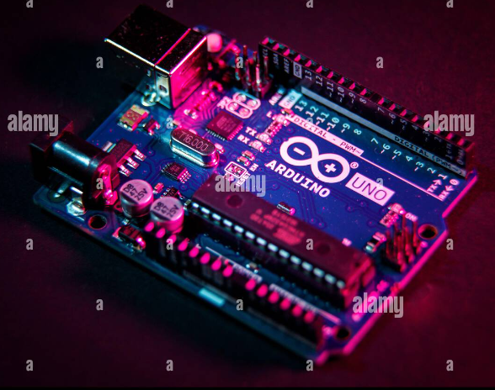
Programming environment of Arduino

Slide 18
Programming environment of arduino
The Arduino Integrated Development Environment - or Arduino Software (IDE) - connects to the Arduino boards to upload programs and communicate with them.
Programs written using Arduino Software (IDE) are called sketches.
These sketches are written in the text editor and are saved with the file extension .
The Arduino Integrated Development Environment - or Arduino Software (IDE) - contains a text editor for writing code, a message area, a text console, a toolbar with buttons for common functions and a series of menus.
It connects to the Arduino hardware to upload programs and communicate with them.

Slide 19

Writing Sketches
Programs written using Arduino Software (IDE) are called sketches.
These sketches are written in the text editor and are saved with the file extension .ino. The editor has features for cutting/pasting and for searching/replacing text.
The message area gives feedback while saving and exporting and also displays errors.
The console displays text output by the Arduino Software (IDE), including complete error messages and other information.
The bottom righthand corner of the window displays the configured board and serial port.
The toolbar buttons allow you to verify and upload programs, create, open, and save sketches, and open the serial monitor.

Slide 20
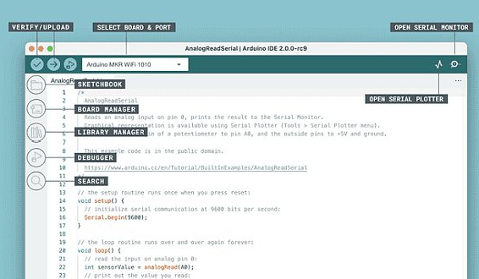

NB: Versions of the Arduino Software (IDE) prior to 1.0 saved sketches with the extension .pde.
It is possible to open these files with version 1.0, you will be prompted to save the sketch with the .ino extension on save.

Slide 21
Verify Checks your code for errors compiling it.
Upload Compiles your code and uploads it to the configured board. See uploading below for details.
Note: If you are using an external programmer with your board, you can hold down the "shift" key on your computer when using this icon.
The text will change to "Upload using Programmer"

Slide 22



GND - Ground pins. The ground pins are used to ground the circuit.
TXD and RXD
TXD and RXD pins are used for serial communication. The TXD is used for transmitting the data, and RXD is used for receiving the data. It also represents the successful flow of data.
USB Interface
The USB Interface is used to plug-in the USB cable. It allows the board to connect to the computer. It is essential for the programming of the Arduino UNO board.
RESET
It is used to add a Reset button to the connection.
SCK
It stands for Serial Clock. These are the clock pulses, which are used to synchronize the transmission of data.
MISO
It stands for Master Input/ Slave Output. The save line in the MISO pin is used to send the data to the master.

Slide 23

VCC
It is the modulated DC supply voltage, which is used to regulate the IC's used in the connection. It is also called as the primary voltage for IC's present on the Arduino board. The Vcc voltage value can be negative or positive with respect to the GND pin.
Crystal Oscillator- The Crystal oscillator has a frequency of 16MHz, which makes the Arduino UNO a powerful board.
ICSP
It stands for In-Circuit Serial Programming. The users can program the Arduino board's firmware using the ICSP pins.
The program or firmware with the advanced functionalities is received by microcontroller with the help of the ICSP header.
The ICSP header consists of 6 pins.
The structure of the ICSP header is shown below:

Slide 24
New Creates a new sketch.
Open Presents a menu of all the sketches in your sketchbook.
Clicking one will open it within the current window overwriting its content.
Note: due to a bug in Java, this menu doesn't scroll; if you need to open a sketch late in the list, use the File | Sketchbook menu instead.
Save Saves your sketch.
Serial Monitor Opens the serial monitor.
Additional commands are found within the five menus: File, Edit, Sketch, Tools, Help. The menus are context sensitive, which means only those items relevant to the work currently being carried out are available.

Slide 25
File
New Creates a new instance of the editor, with the bare minimum structure of a sketch already in place.
Open Allows to load a sketch file browsing through the computer drives and folders.
Open Recent Provides a short list of the most recent sketches, ready to be opened.
Sketchbook Shows the current sketches within the sketchbook folder structure; clicking on any name opens the corresponding sketch in a new editor instance.
Examples Any example provided by the Arduino Software (IDE) or library shows up in this menu item. All the examples are structured in a tree that allows easy access by topic or library.

Slide 26
Close Closes the instance of the Arduino Software from which it is clicked.
Save Saves the sketch with the current name. If the file hasn't been named before, a name will be provided in a "Save as.." window.
Save as... Allows to save the current sketch with a different name.
Page Setup It shows the Page Setup window for printing.
Print Sends the current sketch to the printer according to the settings defined in Page Setup.
Preferences Opens the Preferences window where some settings of the IDE may be customized, as the language of the IDE interface.
Quit Closes all IDE windows. The same sketches open when Quit was chosen will be automatically reopened the next time you start the IDE.

Slide 27
Edit
Undo/Redo Goes back of one or more steps you did while editing; when you go back, you may go forward with Redo.
Cut Removes the selected text from the editor and places it into the clipboard.
Copy Duplicates the selected text in the editor and places it into the clipboard.
Copy for Forum Copies the code of your sketch to the clipboard in a form suitable for posting to the forum, complete with syntax coloring.
Copy as HTML Copies the code of your sketch to the clipboard as HTML, suitable for embedding in web pages.

Slide 28
Paste Puts the contents of the clipboard at the cursor position, in the editor.
Select All Selects and highlights the whole content of the editor.
Comment/Uncomment Puts or removes the // comment marker at the beginning of each selected line.
Increase/Decrease Indent Adds or subtracts a space at the beginning of each selected line, moving the text one space on the right or eliminating a space at the beginning.
Find Opens the Find and Replace window where you can specify text to search inside the current sketch according to several options.
Find Next Highlights the next occurrence - if any - of the string specified as the search item in the Find window, relative to the cursor position.
Find Previous Highlights the previous occurrence - if any - of the string specified as the search item in the Find window relative to the cursor position.

Slide 29
Sketch
Verify/Compile Checks your sketch for errors compiling it; it will report memory usage for code and variables in the console area.
Upload Compiles and loads the binary file onto the configured board through the configured Port.
Upload Using Programmer This will overwrite the bootloader on the board; you will need to use Tools > Burn Bootloader to restore it and be able to Upload to USB serial port again. However, it allows you to use the full capacity of the Flash memory for your sketch. Please note that this command will NOT burn the fuses. To do so a Tools -> Burn Bootloader command must be executed.

Slide 30
Export Compiled Binary Saves a .hex file that may be kept as archive or sent to the board using other tools.
Show Sketch Folder Opens the current sketch folder.
Include Library Adds a library to your sketch by inserting #include statements at the start of your code. For more details, see libraries below. Additionally, from this menu item you can access the Library Manager and import new libraries from .zip files.
Add File... Adds a supplemental file to the sketch (it will be copied from its current location). The file is saved to the
data subfolder of the sketch, which is intended for assets such as documentation. The contents of the data folder are not compiled, so they do not become part of the sketch program.

Slide 31
Tools
Auto Format This formats your code nicely: i.e. indents it so that opening and closing curly braces line up, and that the statements inside curly braces are indented more.
Archive Sketch Archives a copy of the current sketch in .zip format. The archive is placed in the same directory as the sketch.
Fix Encoding & Reload Fixes possible discrepancies between the editor char map encoding and other operating systems char maps.
Serial Monitor Opens the serial monitor window and initiates the exchange of data with any connected board on the currently selected Port. This usually resets the board, if the board supports Reset over serial port opening.
Board Select the board that you're using. See below for descriptions of the various boards.

Slide 32
Port This menu contains all the serial devices (real or virtual) on your machine. It should automatically refresh every time you open the top-level tools menu.
Programmer For selecting a hardware programmer when programming a board or chip and not using the onboard USB-serial connection.
Normally you won't need this, but if you're burning a bootloader to a new microcontroller, you will use this.
Burn Bootloader The items in this menu allow you to burn a bootloader onto the microcontroller on an Arduino board.
This is not required for normal use of an Arduino board but is useful if you purchase a new ATmega microcontroller (which normally come without a bootloader).
Ensure that you've selected the correct board from the Boards menu before burning the bootloader on the target board.

Slide 33
Help
Here you find easy access to a number of documents that come with the Arduino Software (IDE).
You have access to Getting Started, Reference, this guide to the IDE and other documents locally, without an internet connection. The documents are a local copy of the online ones and may link back to our online website.
Find in Reference This is the only interactive function of the Help menu: it directly selects the relevant page in the local copy of the Reference for the function or command under the cursor.
Sketchbook
The Arduino Software (IDE) uses the concept of a sketchbook: a standard place to store your programs (or sketches). The sketches in your sketchbook can be opened from the File > Sketchbook menu or from the Open button on the toolbar. The first time you run the Arduino software, it will automatically create a directory for your sketchbook. You can view or change the location of the sketchbook location from with the Preferences dialog.
Beginning with version 1.0, files are saved with a .ino file extension. Previous versions use the .pde extension. You may still open .pde named files in version 1.0 and later, the software will automatically rename the extension to .ino.

Slide 34
Tabs, Multiple Files, and Compilation
Allows you to manage sketches with more than one file (each of which appears in its own tab). These can be normal Arduino code files (no visible extension), C files (.c extension), C++ files (.cpp), or header files (.h).
Before compiling the sketch, all the normal Arduino code files of the sketch (.ino, .pde) are concatenated into a single file following the order the tabs are shown in. The other file types are left as is.

Slide 35

Libraries
Libraries provide extra functionality for use in sketches, e.g. working with hardware or manipulating data.
To use a library in a sketch, select it from the Sketch > Import Library menu.
This will insert one or more #include statements at the top of the sketch and compile the library with your sketch. Because libraries are uploaded to the board with your sketch, they increase the amount of space it takes up. If a sketch no longer needs a library, simply delete its #include statements from the top of your code.
There is a list of libraries in the reference. Some libraries are included with the Arduino software. Others can be downloaded from a variety of sources or through the Library Manager. Starting with version 1.0.5 of the IDE, you do can import a library from a zip file and use it in an open sketch. See these instructions for installing a third-party library.
To write your own library, see this tutorial.

Slide 36
Third-Party Hardware
Support for third-party hardware can be added to the hardware directory of your sketchbook directory. Platforms installed there may include board definitions (which appear in the board menu), core libraries, bootloaders, and programmer definitions.
To install, create the hardware directory, then unzip the third-party platform into its own sub-directory.
(Don't use "arduino" as the sub-directory name or you'll override the built-in Arduino platform.) To uninstall, simply delete its directory.
For details on creating packages for third-party hardware, see the Arduino Platform specification.

Slide 37
Serial Monitor
This displays serial sent from the Arduino board over USB or serial connector. To send data to the board, enter text and click on the "send" button or press enter.
Choose the baud rate from the drop-down menu that matches the rate passed to Serial.begin in your sketch.
Note that on Windows, Mac or Linux the board will reset (it will rerun your sketch) when you connect with the serial monitor.
Please note that the Serial Monitor does not process control characters; if your sketch needs a complete management of the serial communication with control characters, you can use an external terminal program and connect it to the COM port assigned to your Arduino board.
You can also talk to the board from Processing, Flash, MaxMSP, etc (see the interfacing page for details).

Slide 38
Boards
The board selection has two effects: it sets the parameters (e.g. CPU speed and baud rate) used when compiling and uploading sketches; and sets and the file and fuse settings used by the burn bootloader command.
Some of the board definitions differ only in the latter, so even if you've been uploading successfully with a particular selection you'll want to check it before burning the bootloader. You can find different boards here.
Arduino Software (IDE) includes the built in support for the boards in the following list, all based on the AVR Core.
The Boards Manager included in the standard installation allows to add support for the growing number of new boards based on different cores like Arduino Due, Arduino Zero, Edison, Galileo and so on.

Slide 39

What is ESP8266 NodeMCU?
The ESP8266 NodeMCU is a cheap Wi-Fi microcontroller board. It has a powerful Tensilica L106 32-bit microcontroller unit (MCU) with built-in Wi-Fi.
The NodeMCU board is easy to program and debug because it has a USB-to-serial converter. In the realm of esp 8266 vs esp 32.
It is great for both beginners and experienced developers.
Its small size, low price, and compatibility with the Arduino IDE make it very popular.
So, people use it for all kinds of Wi-Fi projects, like smart home gadgets and sensor networks.

Slide 40
What is Nodemcu ESP8266??
Nodemcu is an open-source development board used to build embedded & IoT-based Applications that required internet-based connectivity.
Nodemcu consists of firmware that runs on the ESP8266 Wi-Fi SoC from Espressif Systems, and hardware that is based on the ESP-12 module.
ESP12E has ESP8266 as a microprocessor which is 32-bit with a clock frequency of 80 MHz & in-built Wi-Fi features.

Slide 41
ESP8266 Arduino Example
You can make a simple web server using ESP8266 and Arduino. It lets ESP8266 host a web page and answer HTTP requests.
With a little code, you can manage GPIO pins, get sensor data, or show information on the web page.
So, this shows how flexible and easy the ESP8266 is for IoT projects.

Slide 42

What is ESP32 Node MCU?
The ESP32 NodeMCU is a high-tech microcontroller board with Wi-Fi and Bluetooth.
It’s based on the ESP32 chip and has a powerful dual-core processor, which means it can do more tasks at once compared to the older ESP8266 NodeMCU.
Besides Wi-Fi, it also has Bluetooth, so it can do even more things.
Plus, it has lots of ways to connect with other devices, like SPI, I2C, and UART.
This makes it perfect for all kinds of IoT projects that need wireless connections and advanced features.

Slide 43





Nodemcu has a flash memory of 4MB with SRAM of 64 kb & EEPROM of 512 bytes. Nodemcu has 16 general-purpose input-output (GPIO) pins & 1 Analog pin to measure analog voltage in the range of 0-3.3v.
Nodemcu ESP8266 has a built-in LED connected to the D4 pin of the board along with a Wake pin which is a D0 pin that is used to wake the Nodemcu board from deep-sleep Mode.

Slide 44
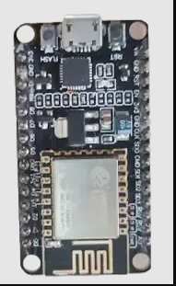


Nodemcu uses various communication protocols such as four pins for SPI communication (Serial Peripheral Interface), two UART (Universal Asynchronous Receiver/Transmitter) Interfaces UART0 (RXD0 & TXD0) and UART1 (RXD1 & TXD1). Nodemcu also provides I2C communication functionality. For I2C communication Nodemcu has GPIO 5 (D1) for SCL and GPIO 4 (D3) for SDA pins, for SPI communication we have GPIO 14 for SCLK.

Slide 45





NodeMCU ESP32
With the NodeMCU-ESP32, comfortable prototyping is possible with simple programming via Luascript or the Arduino IDE and the breadboard-compatible design.
This board has 2.4 GHz dual-mode Wifi and a BT wireless connection.
In addition, a 512 KB SRAM and a 4MB flash memory are integrated into the microcontroller development board.
The board has 21 pins for interface connection, including I2C, SPI, UART, DAC, and ADC.

Slide 46
ESP32 Arduino Example
In the conflict of ESP 8266 vs ESP 32, You can make a weather station with ESP32 and Arduino. ESP32 can connect to Wi-Fi and get weather information from the internet.
Then, it can show the data on a small screen or send it to a website for checking from anywhere. This also shows how ESP32 can connect to the internet and handle data for IoT projects.

Slide 47
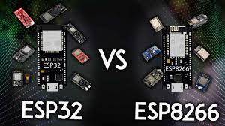

Key Differences Between ESP 8266 vs ESP 32 NodeMCU
While both the ESP 8266 vs ESP 32 NodeMCU share similarities, ESP 32 vs ESP 8266 differ in several key aspects:
1. Processor and Performance:
ESP8266: It features a single-core Tensilica Xtensa LX106 processor clocked at 80MHz.
ESP32: It has a more powerful dual-core Tensilica Xtensa LX6 processor, which operates up to 240MHz. This makes the ESP32 capable of handling more complex tasks and computations compared to the ESP8266.

Slide 48




2. Wi-Fi Connectivity:
ESP8266: Supports 802.11 b/g/n Wi-Fi standards.
ESP32: Supports both 802.11 b/g/n Wi-Fi standards and Bluetooth connectivity, including Bluetooth Low Energy (BLE).
3. Memory:
ESP8266: Typically comes with 64KB of instruction SRAM, 80KB of data RAM, and up to 4MB of flash memory for program storage.
ESP32: Offers more memory than the ESP8266, with options for up to 520KB of SRAM and up to 16MB of flash memory.
This additional memory can be beneficial for storing larger programs and handling more data.

Slide 49






4. GPIO Pins:
ESP8266: Typically has fewer GPIO pins compared to the ESP32.
ESP32: Offers a larger number of GPIO pins, along with support for additional interfaces such as SPI, I2C, UART, and more.
5. Peripheral Support:
ESP8266: Supports basic peripherals like GPIO, SPI, I2C, UART, and PWM.
ESP32: Provides more advanced peripheral support, including touch sensors, capacitive touch, ADCs (Analog-to-Digital Converters), DACs (Digital-to-Analog Converters), and more.

Slide 50
Best ESP8266 Boards
When it comes to selecting the best ESP8266 board for your project, several options stand out:
NodeMCU ESP8266: This board is popular because it has good features and it’s not very expensive.
Wemos D1 Mini: This board is small and has lots of support from the community, making it great for projects with limited space.
Adafruit Feather HUZZAH ESP8266: This board can charge batteries and has many pins for connecting devices, making it perfect for portable projects.

Slide 51
What is the Advantage of ESP32 over ESP8266?
Talking about ESP 8266 vs ESP 32, both are popular microcontrollers that are used in IoT and other projects. While they share many similarities, the ESP32 offers several advantages over the ESP8266:
Dual-core processor: ESP32 has two processors, so it can do more things at once, unlike ESP8266, which only has one.
More GPIO pins: ESP32 has more pins for connecting stuff like sensors and gadgets compared to ESP8266.
More connectivity options: ESP32 can connect with Wi-Fi, Bluetooth, and Bluetooth Low Energy (BLE), while ESP8266 mostly connects with Wi-Fi.

Slide 52


Better power management: ESP32 can save more power in some situations, which is important for things that use batteries.
Enhanced performance: ESP32 is generally faster and better at doing complicated tasks than ESP8266.
Richer peripheral set: ESP32 has more built-in features like touch sensors and support for different communication methods.
More memory: ESP32 has more space for storing programs and data than ESP8266.
ESP8266 is good for simple projects because it is easy to use and cheap. But ESP32 can do more things and is better for harder projects.

Slide 53
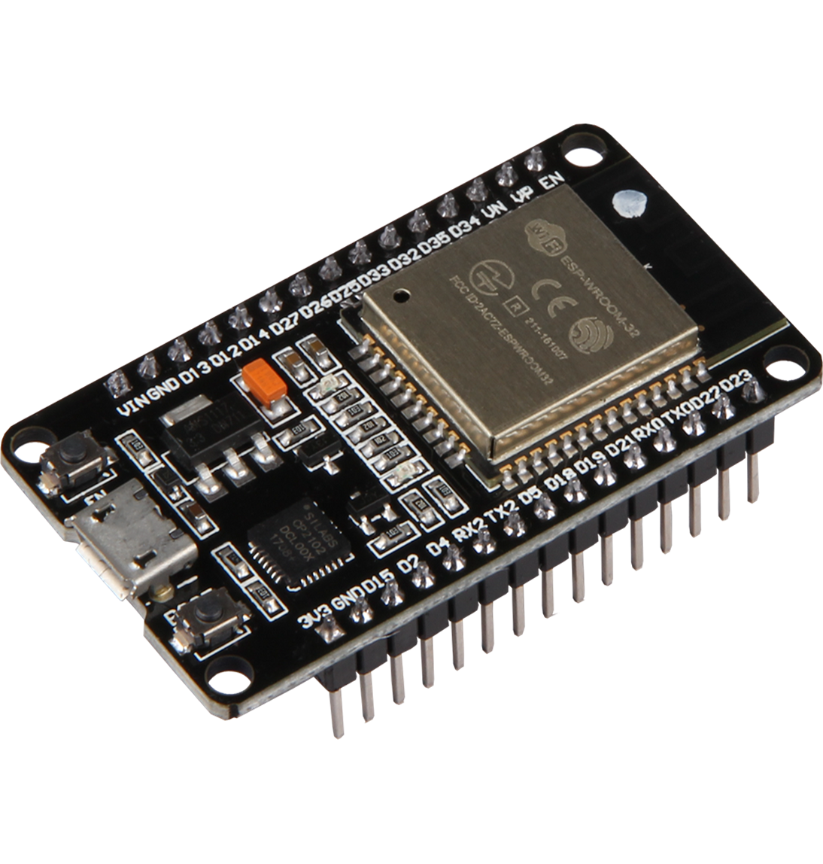
In conclusion, both the ESP 8266 vs ESP 32 NodeMCU offer unique strengths and advantages, catering to a wide range of IoT applications. While the ESP8266 remains a cost-effective solution for simpler projects.
The ESP32 shines in scenarios requiring higher processing power and advanced connectivity options. By understanding their key differences and benefits.
You can also make an informed decision when selecting the right microcontroller for your next project.
When comparing the ESP32 and ESP8266 differences, it is essential to evaluate your project requirements carefully.
To choose the optimal solution that aligns with your goals and budget.
Whether you opt for the simplicity of ESP8266 or the advanced features of ESP32. Both platforms promise endless possibilities for innovation in the IoT landscape.

Slide 54

Basic interfacing techniques and its application in industry for Wireless technologies for IoT

Slide 55
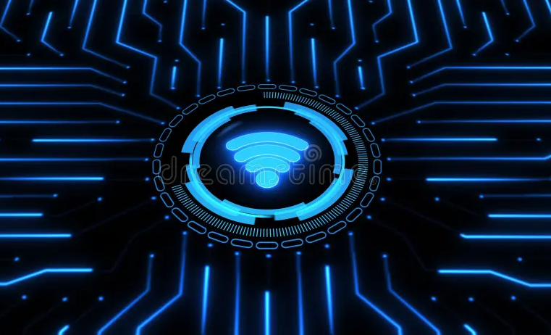
What is Wireless Technology?
Wireless technology is a method of connection within an IoT system that includes sensors, platforms, routers, applications, and other systems.
Each option has trade-offs between power consumption, bandwidth, and range.
At a high level, there are standard wireless options like cellular (3G, 4G, 5G) and WiFi, and there are long-range options like LoRaWAN and LPWAN.
Connected device companies should understand the basics of the top IoT technologies to determine the best wireless technology option for their needs.

Slide 56
1. Cellular
Before we get into how to decide which wireless technology is right for your business, let’s look at the main options available today. These will meet the requirements of most use cases.
One of the best-known types of IoT wireless technology is cellular, particularly in the consumer mobile market.
Cellular networks provide reliable broadband communication that supports everything from streaming applications to voice calls.
Since cellular is so well established, it offers very high bandwidth. Carriers offer Cat-M1 and NB-IoT, cellular options designed to compete with novel LPWAN technologies.

Slide 57
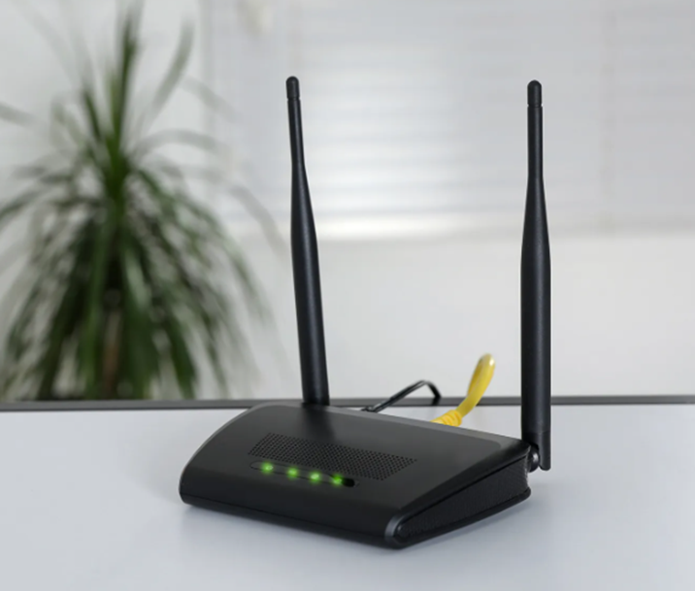

Cellular works well in low power environments, especially with something like Cat-M1.
And for non-mobile applications where power isn't a factor, cellular is also an excellent choice.
With the introduction of 5G’s ultra-low latency, wireless can effectively support the needs of things like time-sensitive industrial automation, real-time delivery of medical data, and public safety surveillance video. It will be exciting to watch this unfold.

Slide 58
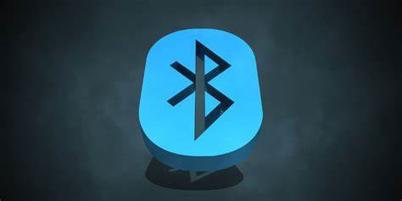

2. Bluetooth and BLE (Bluetooth Low Energy)
Another well-known wireless technology in consumer circles is Bluetooth.
This wireless personal area network (WPAN) is a short-range communication technology with optimization for power consumption (Bluetooth Low Energy) positioned to support small-scale consumer IoT applications.
Bluetooth and BLE are used for everything from fitness and medical wearables like smartwatches to smart home devices like home security systems, where data is communicated to smartphones.
They work quite effectively with very short-range communications.

Slide 59
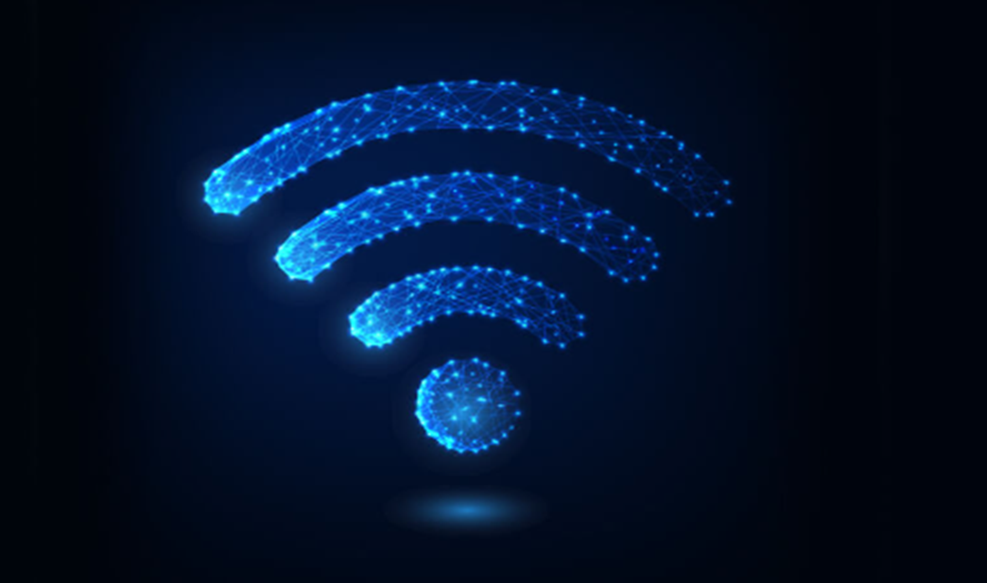

3. WiFi
WiFi has played a critical role in providing high-throughput data transfer in homes and for enterprises — it’s another well-known IoT wireless technology.
It can be quite effective in the right situations, though it has significant limitations with scalability, coverage, and high power consumption.
Due to newer enterprise security practices, IoT devices are discouraged from being added to the same primary Wi-Fi networks as traditional employee computers or phones.

Slide 60
In Zipit's experience, this has led more OEMs to leverage other technologies like cellular to both mitigate these security concerns as well as speed up deployment efforts.
The high energy requirements often make WiFi a poor solution for large networks with battery-operated sensors, such as smart buildings and industrial use.
Instead, it’s more effective with devices like smart home appliances.
The latest WiFi technology, WiFi 6, does offer improved bandwidth and speed, though it’s still behind other available options.
And it carries security risks that other options don’t.

Slide 61



Popular wireless communication technology enables devices to connect to a local network or the internet. Wi-Fi is widely used in homes, offices, and public spaces and is suitable to provide high-speed, high-bandwidth connectivity over short ranges.
Attributes:
Range: up to 50m
Data Rate: ~Mbps
Power Drawn: High
Topology: Star, Tree, P2P
Applications:
Used in homes, offices, and public spaces for internet access and device connectivity, Video Streaming, VoC

Slide 62
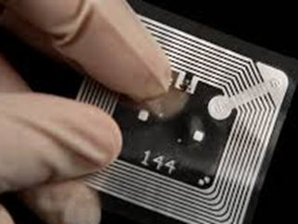

4. LPWAN (Cat-M1/NB-IoT)
Low power wide area networks (LPWAN) provide long-range communication using small, inexpensive batteries.
This family of technologies is ideal for supporting large-scale IoT networks where a significant range is required.
However, LPWANs can only send small blocks of data at a low rate.
LPWANs are ideally suited for use cases that don’t require time sensitivity or high bandwidth, like a water meter for example. They can be quite effective for asset tracking in a manufacturing facility, facility management, and environmental monitoring. Keep in mind that standardization is important to ensure the network’s security, interoperability, and reliability. Although newer LPWAN is gaining popularity.

Slide 63

5. LoRaWAN
LoRaWAN is a powerful and emerging technology. It’s similar to Bluetooth, but it offers a longer range for small data packets with low power consumption.
LoRaWAN manages the communication frequencies, power, and data rate for all connected devices.
So, LoRaWAN sensors communicate to a cellular gateway to send data to the cloud.
It does require a back-haul transport, and partners like Zipit can provide the necessary cellular support.
The use cases for LoRaWAN are similar to those for LPWAN where there aren’t high bandwidth requirements or time sensitivity for the transfer of data.

Slide 64
It’s is a point-to-point wireless connection that does not have direct connection to the Internet, whereas LPWAN is a direct-to-internet connection.
LoRaWAN requires a gateway to packet forward the data to the final destination in the cloud, and that gateway is typically a LoRa to Cellular gateway.
Since the range is high for LoRaWAN, sensors can be widely deployed over a large area.
These sensors are simple and designed for small data packets that transmit infrequently, so it’s well-suited for irrigation management, leak detection, logistics and transportation management, and asset or equipment tracking.
Keep your eyes on LoRaWAN as it continues to evolve.

Slide 65
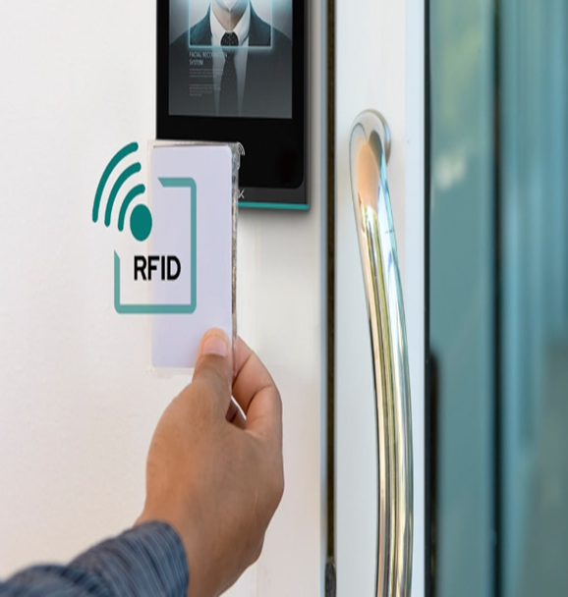
6. RFID-IoT
Radio Frequency Identification (RFID) uses radio frequency signals to track and monitor objects and assets efficiently and accurately.
RFID systems consist of tags, equipped with unique identification numbers, that can be attached to or embedded in objects like credential badges and wearables for sporting events, parking tags to hang in automobiles, loyalty cards, and warehousing labels.
RFID tags exchange information wirelessly but do not connect to the internet directly.
RFID technology requires a gateway and cellular connectivity to send data to a cloud platform

Slide 66
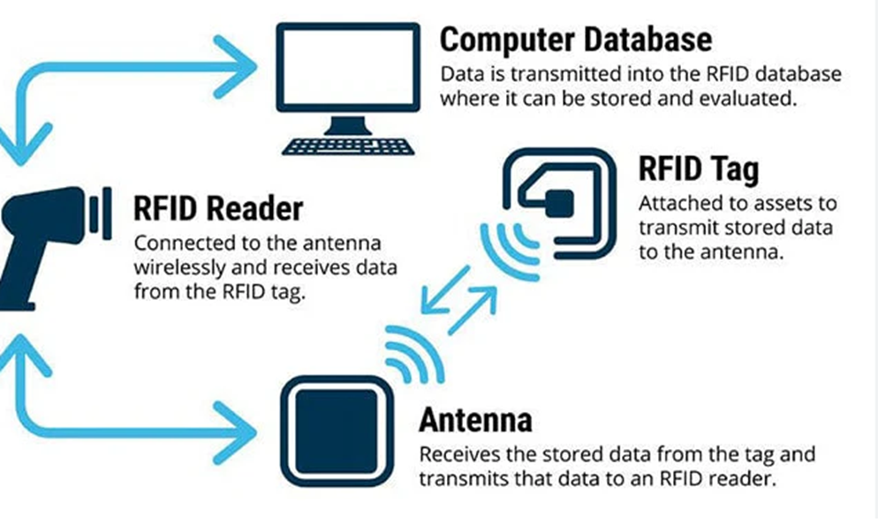

Supply chain management is one area where RFID-IoT plays a vital role.
It enables real-time tracking of products, reducing manual labor and streamlining logistics operations.
By placing RFID tags on goods, companies can effortlessly monitor inventory levels, identify bottlenecks, and optimize the flow of the supply chain.
RFID applications are also used in healthcare for patient tracking, medication management, and equipment monitoring.
Hospitals can use RFID-enabled wristbands to identify and locate patients, ensuring their safety and well-being.
Medications can be tagged with RFID labels to automate inventory management, prevent errors, and enhance patient care.

Slide 67


Attributes
Range: Up to 100m
Data Rate: Vary with Freq
Power Drawn: Low
Topology: Point to Point
Application
Retail & Logistics

Slide 68

7.Zigbee
Zigbee is a wireless protocol designed for short-range, low-power, wireless standards commonly used to extend coverage by relaying sensor data over multiple sensor nodes.
Compared to LPWAN, Zigbee provides higher data rates, but at the same time, much less power efficiency due to mesh configuration.
Zigbee is a wireless communication protocol that is designed for low-power, low-data-rate devices.
Zigbee uses mesh networking to enable communication between devices and supports a wide range of applications.

Slide 69




Attributes
Range: < 100m
Data Rate: 250Kbps
Power Drawn: Low
Topology: Mesh
Low Cost, Low Power
Application
Home automation, Smart lighting, HVAC control, Traffic Management System.

Slide 70

8. Cellular Networks (4G, 5G)
Cellular networks, such as 3G, 4G, and 5G, are commonly used in IoT devices that require high-speed, long-range connectivity.
These networks provide coverage over large areas, it provides local coverage and are ideal for applications where devices are located in urban or suburban areas.
Cellular networks typically have higher data rates than satellite networks and lower latency due to their proximity to the devices.
The data rate for cellular networks can vary depending on the specific network technology used (e.g., 4G LTE, 5G), but it can range from a few megabits per second to several hundred megabits per second.
The range of a cellular network depends on several factors, such as the network infrastructure and the density of cell towers, but it typically ranges from a few hundred meters to several kilometers.

Slide 71

Attributes
Data Rate: x Mbps
Range: ~ Kms
Application
Consumer Mobile, Asset tracking, Fleet management, and Remote monitoring.

Slide 72



9.Satellite Networks
Satellite networks provide wide-area coverage and are ideal for applications where devices are located in remote or inaccessible areas, so used in IoT devices that require connectivity in remote or isolated locations where cellular coverage is unavailable.
These networks provide global coverage, however, satellite networks typically have low data rates and high latency due to the long distances involved.
The data rate for satellite networks can vary depending on the specific satellite network used, but it typically ranges from a few kilobits per second to a few megabits per second.
The range of a satellite network is essentially unlimited, as long as the satellite has line-of-sight to the device.

Slide 73
Attributes
Data Rate: x Kbps — x MBps
Range: Unlimited with a clear line of sight b/w satellite and device
Application
Consumer Mobile, Asset tracking, Fleet management, and Remote monitoring.

Slide 74
10.Infrared
Wireless technology that uses the infrared light spectrum to transmit data between devices. Limited range and lower data rates.
Infrared communication typically offers lower data rates compared to other wireless communication technologies such as Wi-Fi, Bluetooth, or cellular networks.
The data rate can range from a few kilobits per second to a few megabits per second, depending on the implementation.
The range of infrared communication is also limited, typically ranging from a few centimeters to a few meters.
Infrared communication requires a clear line of sight between the transmitting and receiving devices, which means that obstacles such as walls or objects can block the signal.

Slide 75
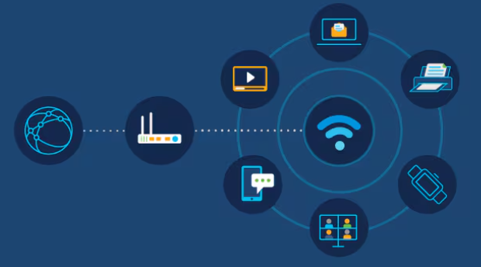



Infrared communication is more secure compared to other wireless communication technologies because the signal cannot pass through solid objects.
This makes it ideal for applications where security is a concern, such as in point-to-point communication between two devices in close proximity.
Infrared communication is also low power and does not interfere with other wireless signals, making it suitable for use in battery-powered devices or in environments with high electromagnetic interference.

Slide 76
Attributes
Data Rate: x KBps
Range: up to a few meters
Topology: Point to Point
Application
TV remote controls, as well as industrial applications such as factory automation and surveillance.

Slide 77

11.NFC (Near Field Communication)
The short-range wireless technology used for communication between two devices that are brought into close proximity with each other with better data security than an open network. Low-range & Expensive
Attributes
Topology: Point to Point
Range: <10cm
Data Rate: 424 Kbits/s
Power Drawn: Low
Application
Mobile payments, Access control, and Data exchange between devices.

Slide 78
12.NB-IoT (Narrowband Internet of Things)
Narrowband Internet of Things (NB-IoT) is a cellular network technology designed for low-power IoT devices.
It operates on a licensed spectrum and provides a low-cost, low-power alternative to traditional cellular networks for IoT applications.
Uses existing cellular infrastructure to provide wide-area coverage and supports a large number of devices over a single network.
Though t is having low Data rates, but more secure and reliable than unlicensed spectrum. Battery Life: More than 10 Yrs.

Slide 79

Attributes
Range: 1–15 Km
Data Rate: 200–250 Kbps
Power Drawn: Low
Topology: Star
Licensed Spectrum
Application
Smart meters, Wearables, and Smart Home devices

Slide 80


13. Sigfox
Sigfox is a low-power, wide-area network (LPWAN) technology that uses unlicensed spectrum to connect IoT devices. It is designed for applications that require low data rates and long battery life. Sigfox is a proprietary technology with more limited access to the underlying technology and requires a subscription to use its network
Attributes
Range: 5–20 Km
Data Rate: 50Kbps
Power Drawn: Low
Topology: Star
Un Licensed Spectrum
Application
Asset tracking, Remote monitoring, Smart Parking, and Smart cities.

Slide 81

Which IoT Wireless Technology is the Best?
It’s important to understand the different IoT wireless options available to help you know what option(s) you may want to consider for your business.
There really isn’t a single best option — it depends on your specific needs.
Additionally, some of these technologies may be used effectively together for a more robust solution.

Slide 82
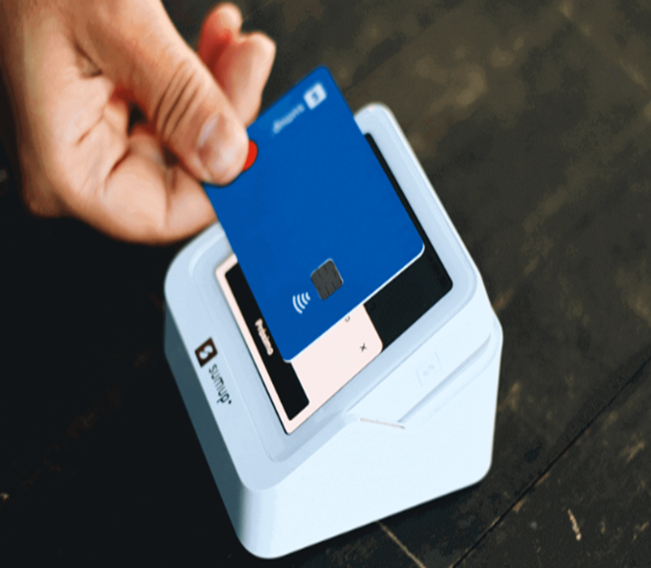
A great example is the Smardii sensor created for individuals caring for patients with incontinence.
The sensor is applied to the incontinence protection and communicated with a LoRaWAN to a cellular gateway to send data to the cloud and the caregivers so they can act on the data.
It’s a great example of a novel approach fueled by this technology to improve care.

Slide 83
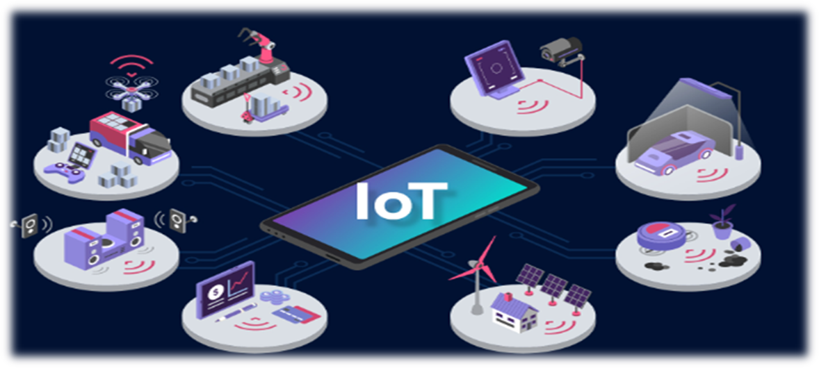
How to Choose an IoT Wireless Technology for Your Product
To choose the right IoT wireless technology, you’ll evaluate the options available based on your specific needs.
Weigh the trade-offs between power consumption, range, and bandwidth and prioritize the importance of each for your product.
Some of what you’ll consider with this analysis are aspects like data range, battery size, cost, transmission distance, carrier-deployed vs. customer-deployed, and where it gets deployed, firmware updates, and more.

Slide 84
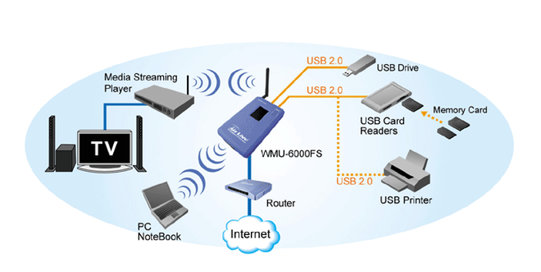
In conclusion, the world of wireless technologies is vast and ever-evolving, offering a range of options for connecting IoT devices.
From traditional cellular networks to emerging LPWAN technologies, each wireless protocol has its own unique advantages and limitations.
As IoT continues to expand and transform various industries, it’s important to understand the different wireless technologies available and how they can be leveraged to create innovative solutions.
By choosing the right wireless technology for their specific use cases, businesses and organizations can unlock the full potential of IoT and drive meaningful impact.

Slide 85

Unit-2

Slide 86

WiFi Technologies

Slide 87
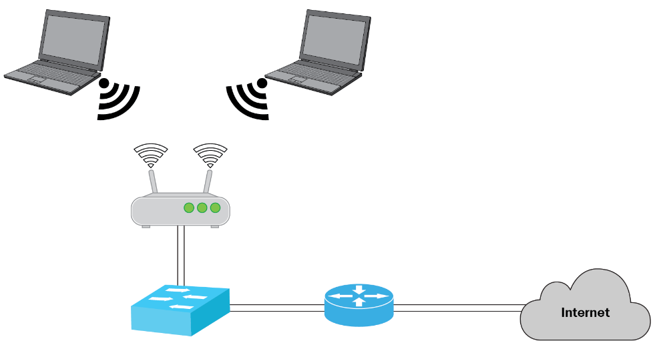
Introduction on Wi-Fi communication
Connectivity between IoT devices and outside world
dictates network architecture
● Choice of communication technology dictates IoT device
hardware requirement and costs
● Due to presence of numerous applications of IoT
enabled devices, a single networking paradigm not
sufficient to all needs of the consumer or IoT device
● Complexity of networks - interference among devices,
network management, heterogeneity in networks,
protocol standardization within networks

Slide 88
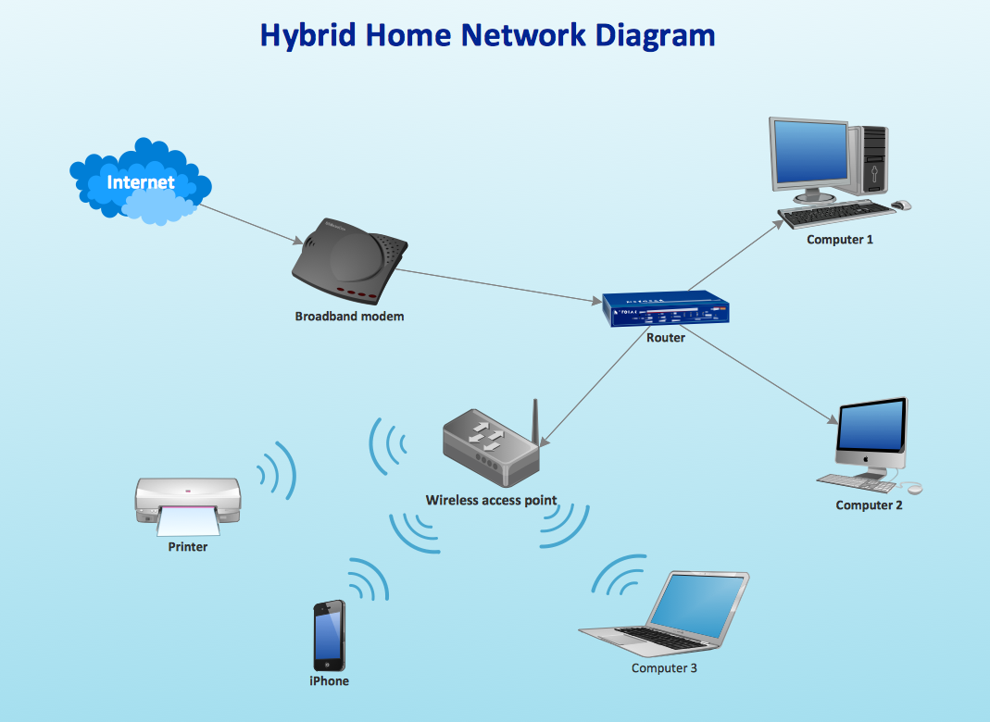
LAN : Local short range communication, may or may not
connect to Internet
WAN : Connection of various network segments,
connects to internet
Node : connects to other nodes via LAN, maybe
connected to other nodes via WAN directly
Gateway : A router connecting LAN to WAN and Internet,
can implement several LAN and WAN, forwards packets
between LAN and WAN
Proxy : Performs active application layer functions
between nodes and other entities

Slide 89

Various Wi-Fi modules
1. **ESP8266**: A low-cost Wi-Fi microchip with full TCP/IP stack and microcontroller capability.
2. **ESP32**: An advanced version of ESP8266, offering dual-core processors, Bluetooth, and more GPIOs.
3. **Arduino WiFi Shield**: Adds Wi-Fi capability to Arduino boards, making it easy to connect to the internet.
4. **Particle Photon**: A small Wi-Fi development kit for creating connected projects and products.
5. **WiFi101 Shield**: Compatible with Arduino, it provides a simple way to add Wi-Fi connectivity.
6. **CC3200**: A single-chip microcontroller with built-in Wi-Fi, designed for IoT applications.
7. **RN171**: A standalone, embedded Wi-Fi module that simplifies the process of adding Wi-Fi to embedded applications.
8. **Wemos D1 Mini**: A mini Wi-Fi board based on ESP8266, perfect for small IoT projects.

Slide 90
ESP8266 and ESP32
(Refer slides from 48-62)

Slide 91
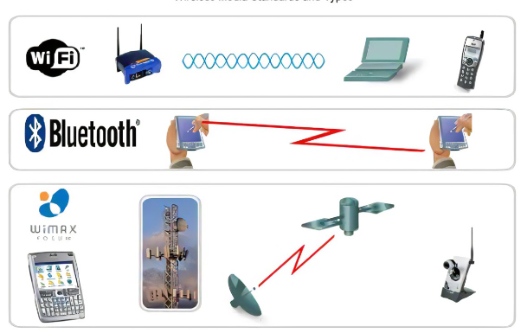

Wi-Fi networks for data transmission
A wireless network is a grouping, or network, of multiple devices where data is sent and received over radio frequencies.
Wireless networks differ from wired networks, which require each end of a data connection to be physically connected by a cable in order for communication to take place.

Slide 92
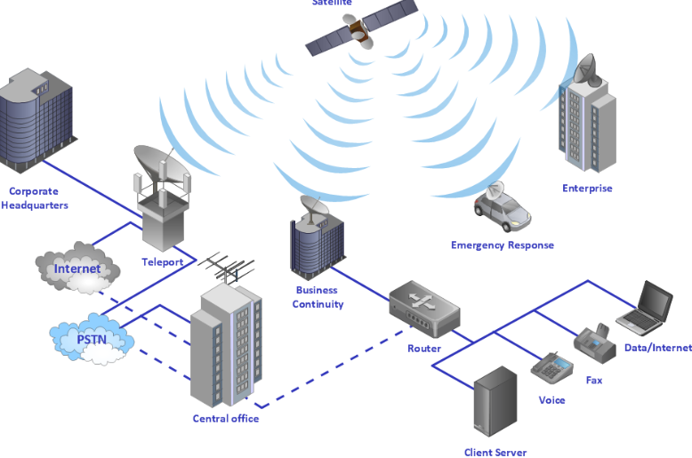
WiFi Significance in IoT applications
IoT has several benefits, some of which are listed below: Better communication between the connected devices.
The ability to obtain details from anywhere and at all times on all devices. The ability to transfer data packets across a unique and connected network thereby saving money and time.

Slide 93
ESP8266 and ESP32
(Refer slides from 64-89)

